Slide 1
Big-O Notation

Slide 2
What is Big-O?
A way to express worst-case performance
Common Big-O Types
Big-O | Example
O(1) | Access element
O(n) | Loop
O(n²) | Nested loops
O(log n) | Binary search

Slide 3
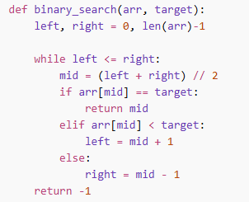
Binary Search Example – O(log n)
Each step halves the data very fast

Slide 4
Big-O Simplification Rules
O(2n) → O(n)
O(n + 10) → O(n)
O(n² + n) → O(n²)

Slide 5

Big-O in Real-World Programs Example 1: Searching Users
Linear Search – O(n)
Dictionary Lookup – O(1)

Slide 6

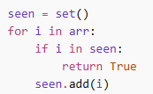
Big-O in Real-World Programs Example 2: Duplicate Check
Bad
Clean & Efficient
Clean Code + Performance:
Clean code:
easier to optimize
easier to refactor
easier to scale

